Slide 1

Neonatal Care Report
Implementation Guide for CDA
Release 2 – Level 3
Children’s Hospitals Neonatal Consortium

Slide 2
Overview
Purpose
Industry Sponsors
Why HL7?
Objectives and deliverables
Approach
Project team subject matter experts
Q&A

Slide 3

Ultimate Purpose
Improve decision making resulting in neonatal care that is more safe, effective and efficient
Notes:
The rationale for developing this database is the profound lack of knowledge regarding best practices for and expected outcomes of infants with uncommon neonatal diseases and the lack of knowledge of the effectiveness and safety of many costly, sometimes highly invasive interventions that have been developed for the care of these infants. Over time it is anticipated that this database will have the most worldwide available information on a number of uncommon neonatal diseases, so that data from this database could be used to counsel parents on ranges of anticipated outcomes of their infants and could lead to improved decision-making both on the part of health care providers and families regarding various interventions.
IOM definition: Comparative effectiveness research - CER is the generation and synthesis of evidence that compares the benefits and harms of alternative methods to prevent, diagnose, treat and monitor a clinical condition, or to improve the delivery of care. The purpose of CER is to assist consumers, clinicians, purchasers, and policy makers to make informed decisions that will improve health care at both the individual and population levels.

Slide 4
Industry Sponsors
Child Health Corporation of America
  CHCA Owner Hospitals are North America’s leading children’s hospitals
  43 children’s hospitals represent more than 20,000 physicians, 100,000 employees
Children’s Hospitals Neonatal Consortium
  21+ children’s hospital NICUs with unique patient populations interested in collaborating to improve patient care
  Formed in 2006; Developed extensive list of desired data elements for sharing
Notes:
The smallest patients
Unique needs
Unique data
Organized business coalition of children’s hospitals
Unrelated EHRs
Unrelated ownership and management
Great potential for demonstration of data collection and analyses from disparate systems
Many are CHCA owners – but not exclusively

Slide 5
Why HL7?
Use data standards to support electronic reporting of an initial segment of data elements in the CHNC Neonatal Intensive Care Unit (NICU) Core Data Set (CDS) from Neonatal Intensive Care providers to CHNC, managed by CHCA
Foundation to support for future performance improvement work
Notes:
Standards supported “Comparative effectiveness research”.
IOM definition: Comparative effectiveness research - CER is the generation and synthesis of evidence that compares the benefits and harms of alternative methods to prevent, diagnose, treat and monitor a clinical condition, or to improve the delivery of care. The purpose of CER is to assist consumers, clinicians, purchasers, and policy makers to make informed decisions that will improve health care at both the individual and population levels.
Initial data focus:
Demographic Data
Gestation duration and a subset of birth and admission statistics
“Acuity Data Elements”
A collection of data elements whose variants are thought to be significant indicators of the severity of illness and of subsequent infant outcomes
(HL7: SDWG primary sponsor, CHWG co-sponsoring, PCWG invited to co-sponsor)

Slide 6








NICU -A
NICU -B
NICU -C
NICU -F
NICU -E
NICU -D
Notes:
Might point out that the arrows are only pointing in one direction to reflect current project – the report to the CHNC database housed at CHCA.
This reflects one component of the overall vision.

Slide 7
Objectives and Deliverables
A prose implementation guide:
  Defining a subset of NICU monitoring data for reporting
  Providing consensus among the neonatal data set developers and standards community prior to bringing the full data set into standard format
A report sample file
Schematron
A rendering style sheet

Slide 8
Project Team:
Subject Matter Experts
David J. Durand, MD: ddurand@mail.cho.org
  Director, Division of Neonatology - Children's Hospital and Research Center Oakland
Karna Murthy, MD: k-murthy@northwestern.edu
  Attending Neonatologist, Assistant Professor of Pediatrics, Northwestern University, Children’s Memorial Hospital
Mike Padula, MD: padula@email.chop.edu
  Attending Neonatologist , Director - Neonatal IT ,Children’s Hospital of Philadelphia
Feliciano (Pele) Yu, MD: fyu@peds.uab.edu
  Information Technology Division, Children's Hospital of Alabama and University of Alabama at Birmingham School of Medicine

Slide 9
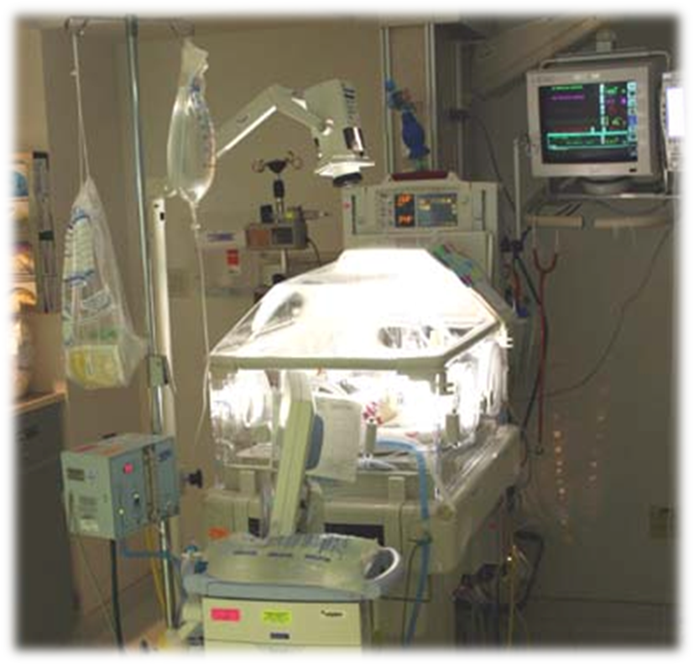
Questions ?

